Slide 1
Becoming an Activated Patient – Part 2
Kenneth Brummel-Smith, MD
Charlotte Edwards Maguire Professor of Geriatrics
Florida State University College of Medicine

Slide 2
Areas to Master
Managing symptoms
Medication use
Emergencies
Nutrition
Exercise
Working with providers
Smoking
Stress reduction
Community resources
Work
Care-givers
Psychological responses

Slide 3
Managing Symptoms
HealthWise

Slide 4
Medication Use - General
Always try generics first
Try to limit the number of drugs
  Greater than 4 is risky
  Ask if you can stop a drug when a new one is started
Consider any new symptom as a possible side effect
  If a new symptom starts, don’t use a new medicine unless it is clear it is not a side effect

Slide 5
Medication List
Name | Dose | Taken | For | Target | Goal
Tylenol | 500mg | 3 times a day | Arthritis | Pain < 5/10 | Walking 30 minutes 5 times a week
Hydrochloro-thiazide (HCTZ) | 12.5mg | Every morning | High blood pressure | 140/85 | Avoid a stroke or heart attack
Metformin | 1000mg | Twice a day | Diabetes | A1C 7.5-8 | Avoid a stroke or heart attack

Slide 6
Working with Providers
Make a prioritized list of topics to discuss
Bring up the most important issue first
Be willing to question
Assertiveness – “DESC script”
  Describe
  Express
  Specify
  Consequence

Slide 7
Working With Providers
Ask about other ways to access them – email?
If a lab test is ordered
  Ask – how will the results change my treatment?
If an elective procedure is recommended
  Ask about the benefits
  Ask about the harms
  Get absolute percentages
  Remember the principles of informed consent

Slide 8
Smoking
Stop!!!!
Stop!!!!
Stop!!!!
Groups, programs, family support
Questionable value of medications

Slide 9
Community Resources
Tallahassee Senior Center
Hospital based training
Health plan resources
Advocacy groups
  American Diabetes Association
  Arthritis Association
  American Heart Association
  Alzheimer’s Project & Alzheimer’s Association

Slide 10
Online Resources
FamilyDoctor.org
  www.familydoctor.org
Worst Pills, Best Pills
  www.worstpills.org
MedlinePlus
  http://www.nlm.nih.gov.ezproxy.med.fsu.edu/medlineplus/
Health in Aging
  www.healthinaging.org
NIA Age Pages
  www.nia.nih.gov

Slide 11
Online Decision Aids
Informed Medical Decisions Foundation
  www.informedmedicaldecisions.org
Dartmouth Decision Aid Library
  http://www.dartmouth-hitchcock.org/medical-information/decision_aid_library.html

Slide 12
Work/Volunteer
An issue often more important for care givers for older persons
Work is related to positive self concept
Appropriate accommodations
Adjustment of self image
  Related to psychological responses

Slide 13
Care Givers
Care giver stress
  Depression
  Work problems
  Financial loss
  Abuse
Group support & education
Respite

Slide 14
Psychological Health
Be open to discussing your feelings
Prevention through stress management and exercise
Support groups
Using professional resources
Benefits and risks of medicines
  Depression isn’t sadness
  TV selling of “diseases”

Slide 15
Advance Care Planning
Go Wish Cards
  www.gowish.org
The Conversation Project
  http://theconversationproject.org/starter-kit/intro/
Prepare for Your Care
  www.prepareforyourcare.org
My Directives.com
  https://www.mydirectives.com

Slide 16
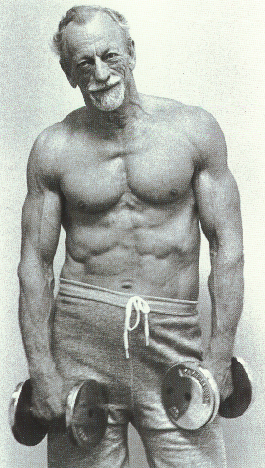
John Turner, MD
67 y/o
“I think physicians have a
responsibility to sell health
at least as much as they
sell pills.”
Growing Old is Not for Sissies
Etta Clark
Pomegrante Books
Petaluma, CA 1990

